Slide 1
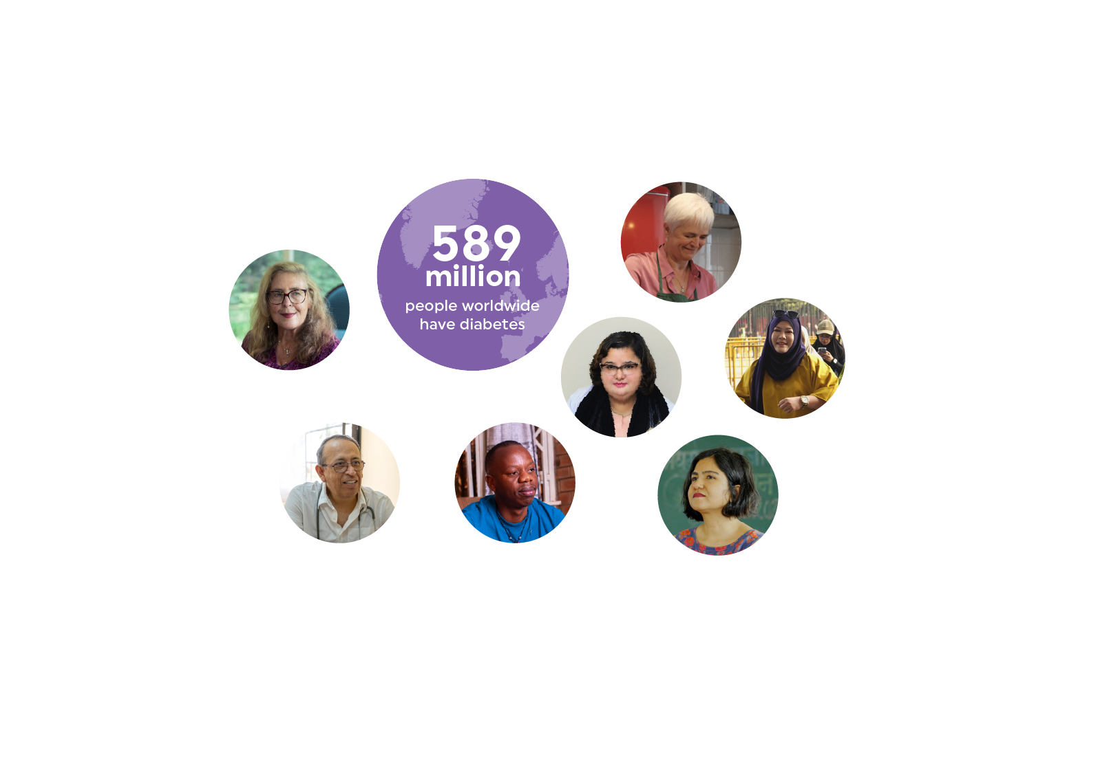

IDF Diabetes Atlas 11th Edition
diabetesatlas.org

Slide 2








Highlights
In 2024, the IDF Diabetes Atlas estimates that:
1 in 9
Adults (20-79 years) has diabetes
589 million people
1 in 8
Adults (20-79 years) has impaired glucose tolerance
635 million people
1 in 11
Adults (20-79 years) has impaired fasting glucose 488 million people
1 in 4
Adults over 65 years has diabetes
158 million people
4 in 10
Adults with diabetes
are undiagnosed
252 million people
1 in 5
Live births (23 million) are affected by hyperglycaemia in pregnancy, 79% have mothers with GDM
11.9%
Of global health expenditure is spent on diabetes (over USD 1 trillion)
3 in 4
Adults with diabetes live in low- and middle-income countries
1.8 million
Children and adolescents below 20 years have type 1 diabetes
3.4 million
Deaths are attributed to diabetes

Slide 3
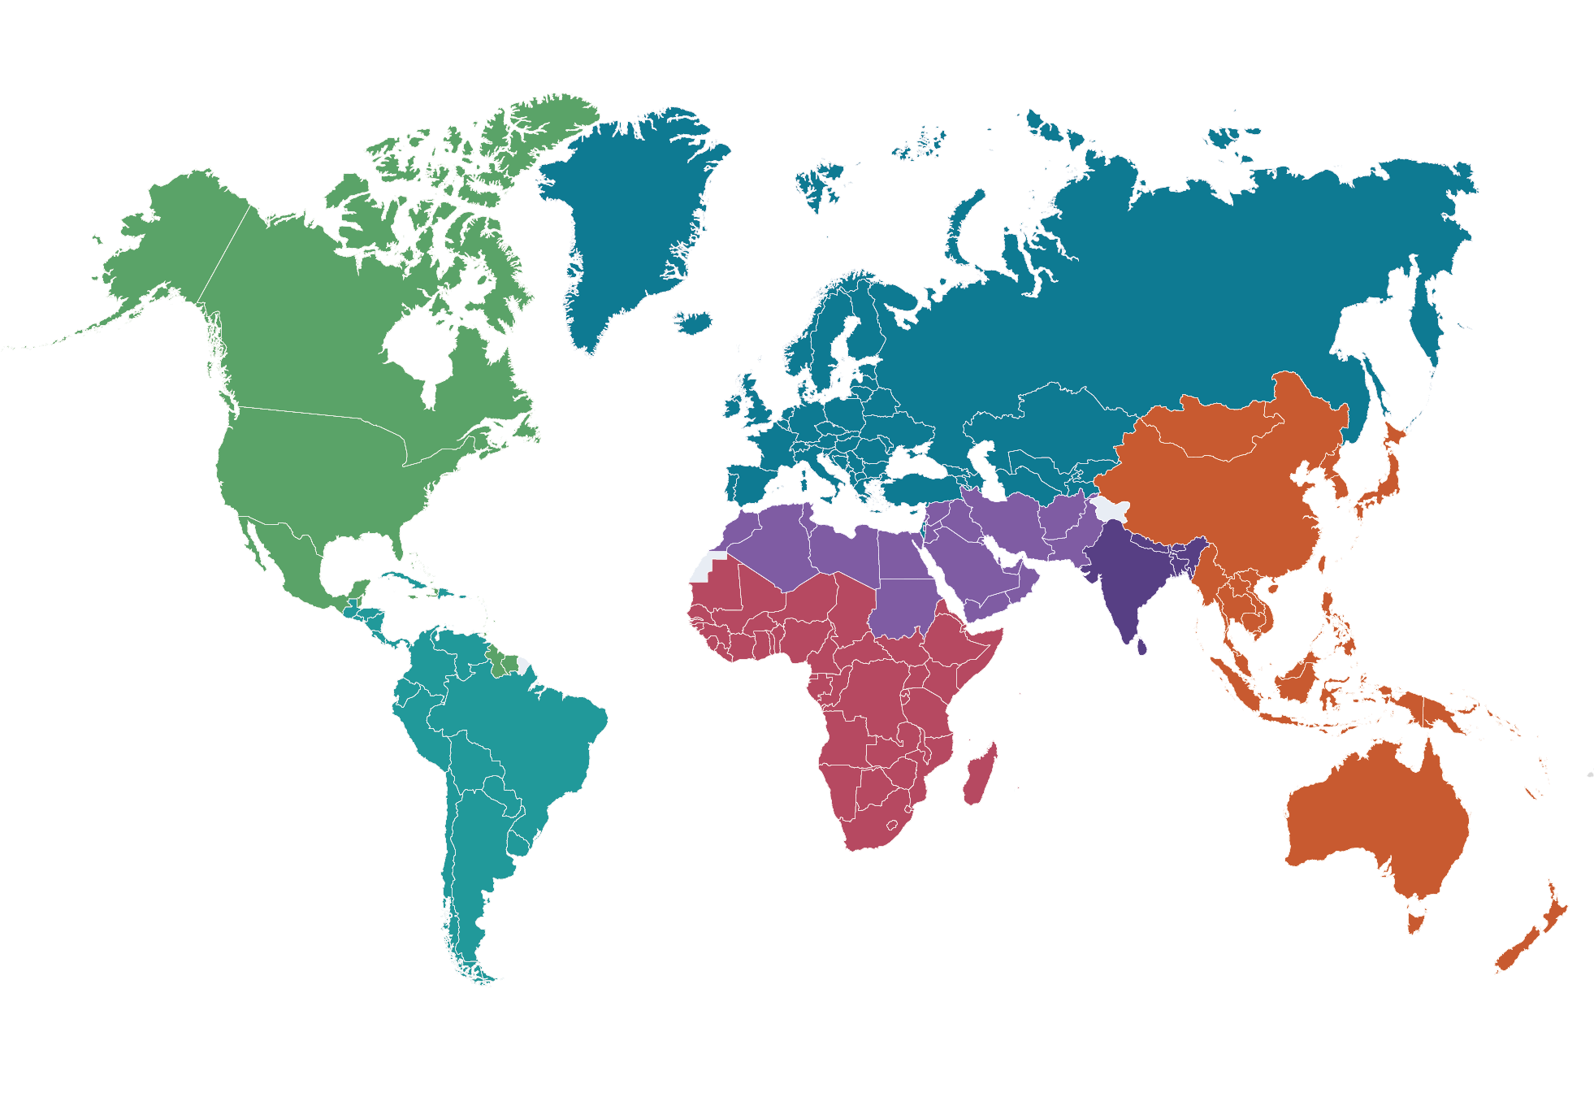
Number of people with diabetes
Aged 20-79 years, globally and by IDF Region
World
Africa (AFR)
2050
852.5 million
45%
2050
59.5 million
142%
2024
588.7 million
increase
2024
24.6 million
increase
Europe (EUR)
Middle-East and North Africa (MENA)
2050
72.4 million
10%
2050
162.6 million
92%
2024
65.6 million
increase
2024
84.7 million
increase
North America and Caribbean (NAC)
South and Central America (SACA)
2050
68.1 million
21%
2050
51.5 million
45%
2024
56.2 million
increase
2024
35.4 million
increase
South-East Asia (SEA)
Western Pacific (WP)
2050
184.5 million
73%
2050
253.8 million
18%
2024
106.9 million
increase
2024
215.4 million
increase

Slide 4
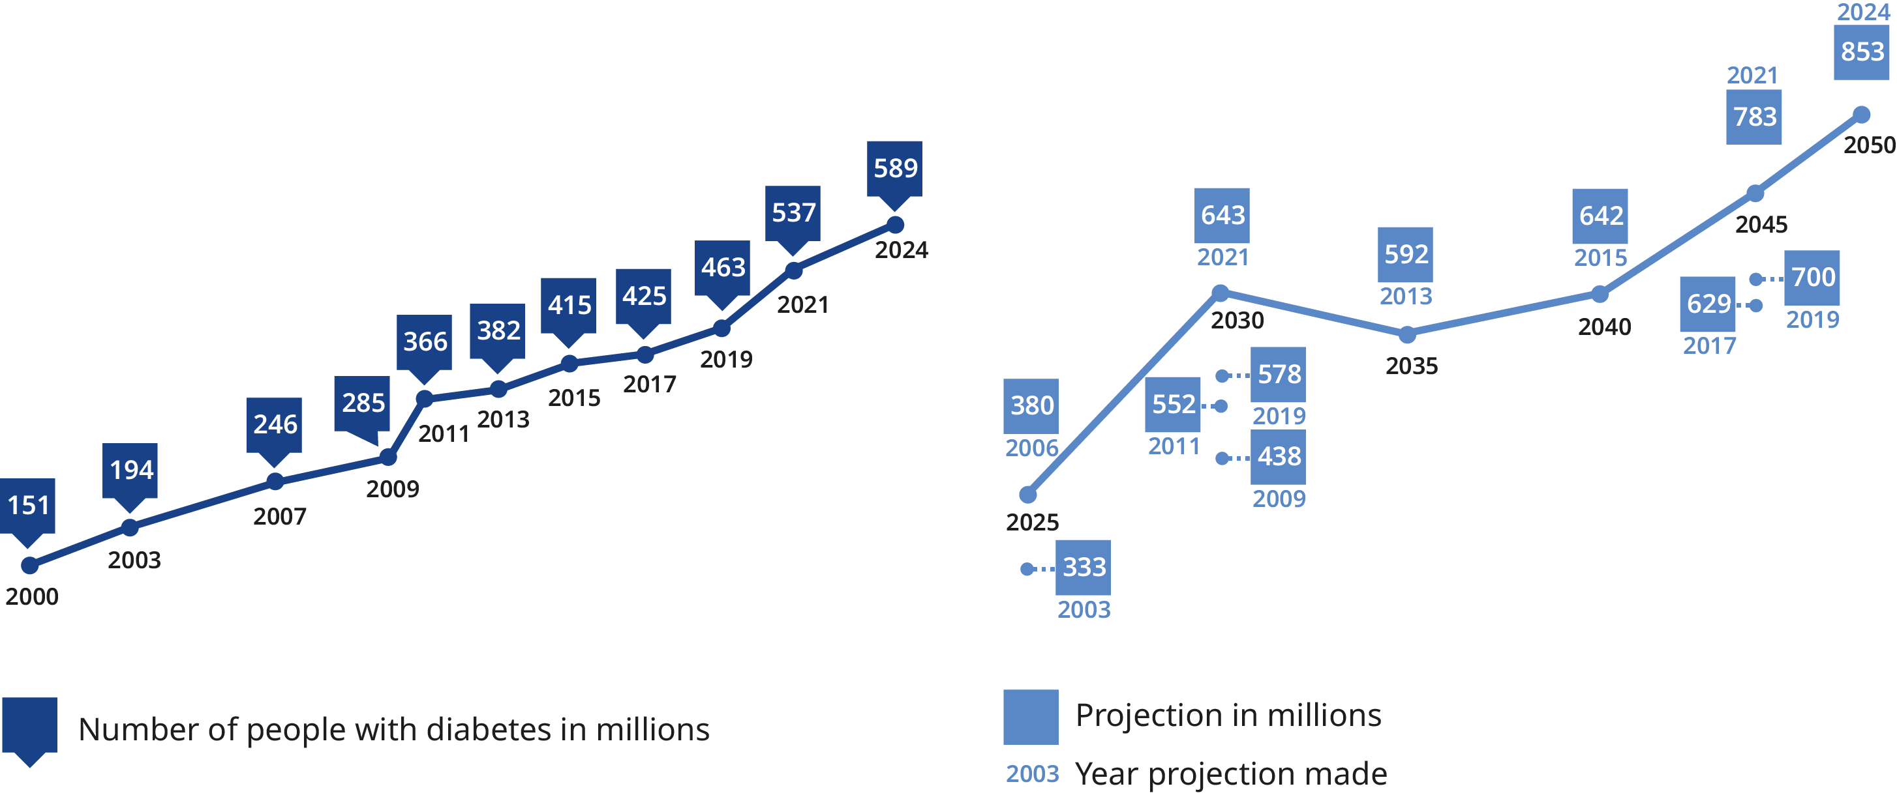
Estimates and projections
Global number of adults (20-79 years) in millions
Estimates of the global prevalence of diabetes in the 20­–79 year age group (millions)
Projections of the global prevalence of diabetes in the 20­–79 year age group (millions)

Slide 5
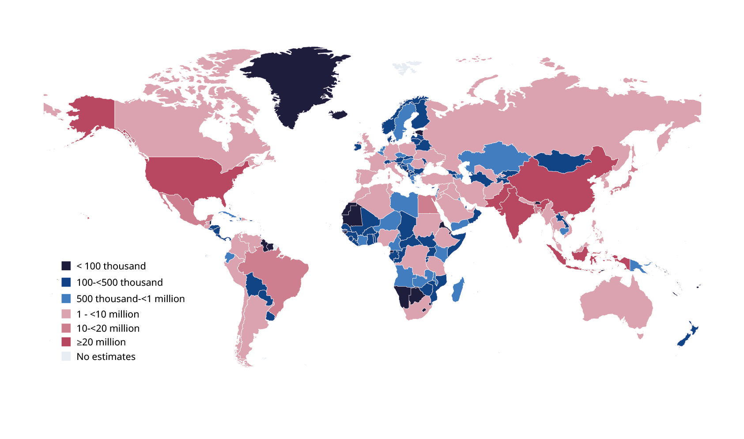
Number of adults with diabetes
Age 20-79 years, 2024

Slide 6
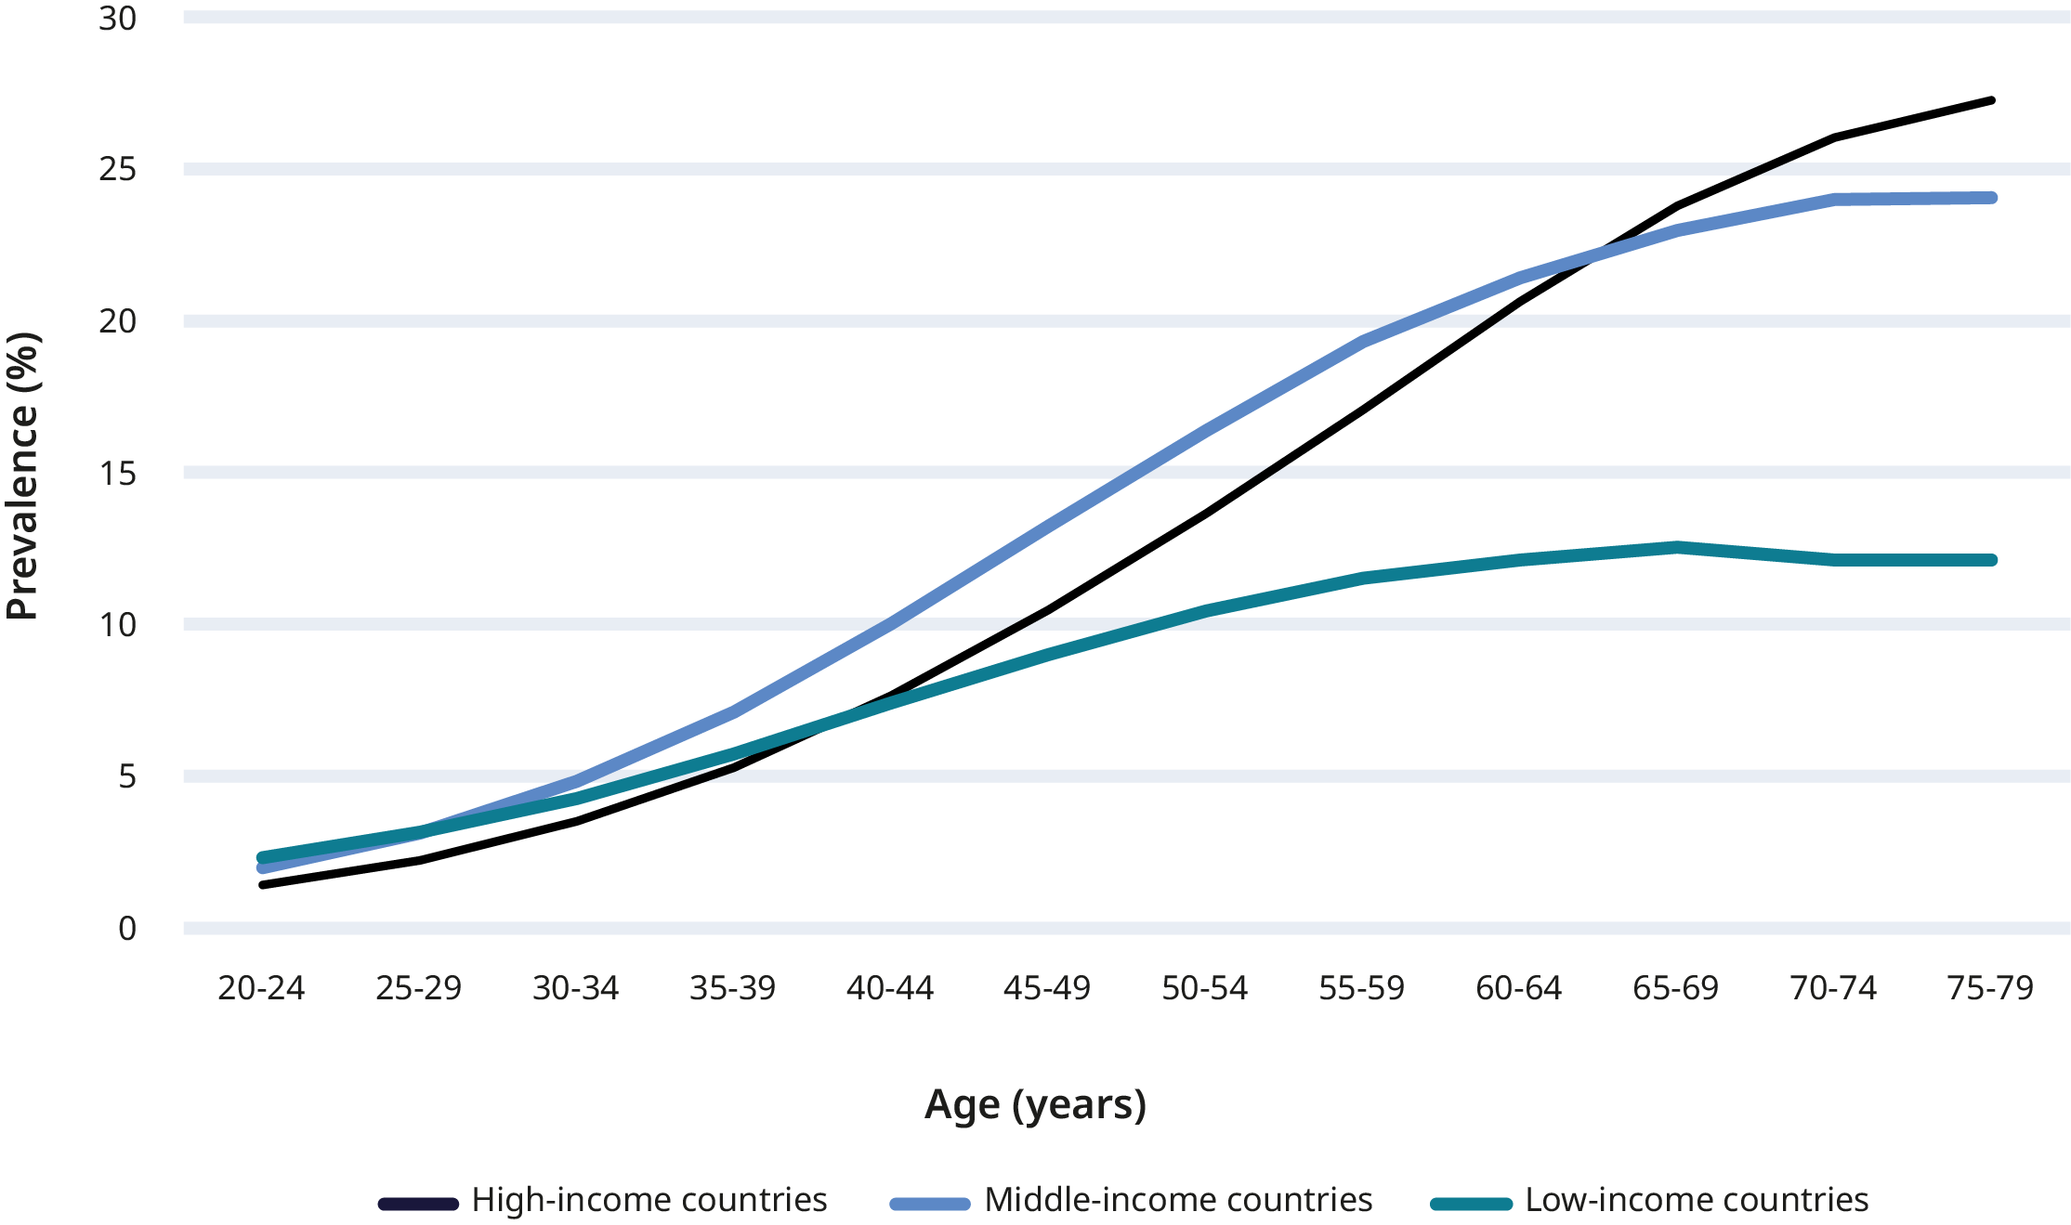
Prevalence of diabetes
By age and income group (%), 2024

Slide 7
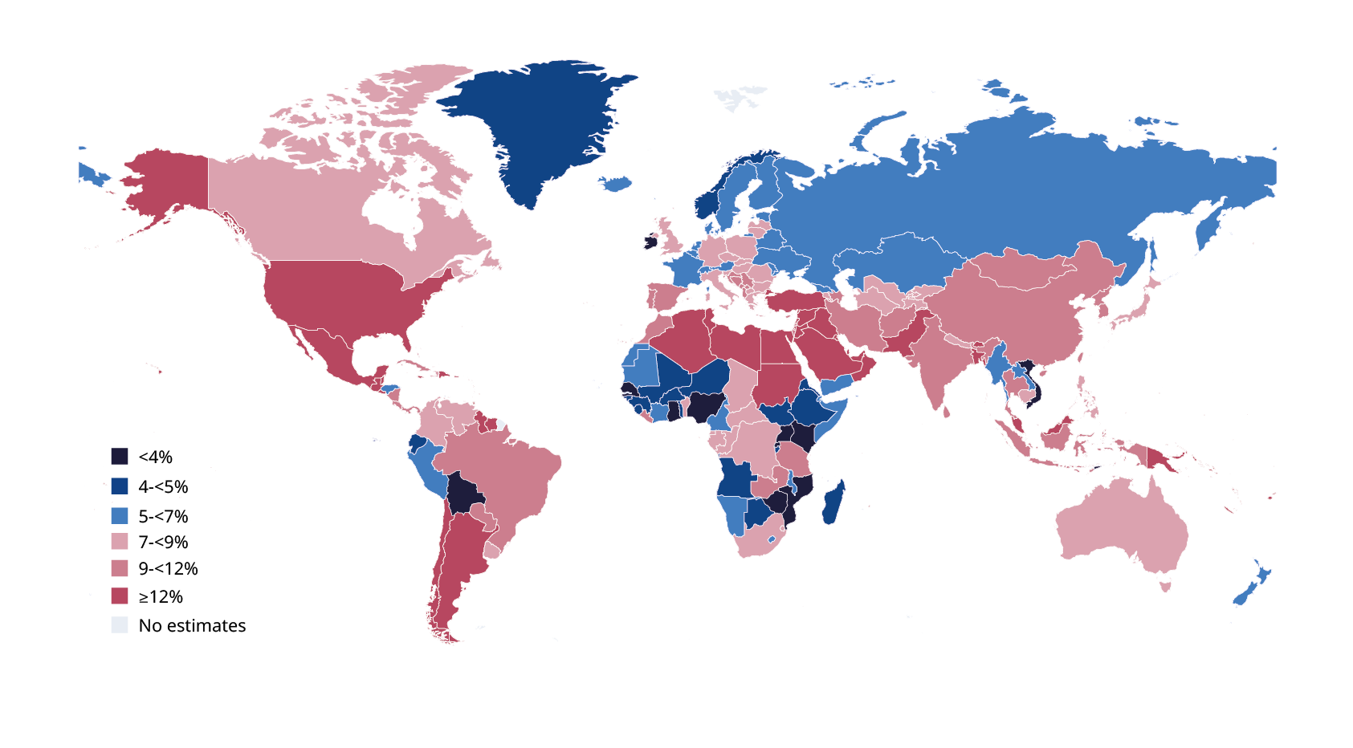
Estimated age-adjusted comparative prevalence of diabetes
In adults aged 20-79 years, 2024

Slide 8
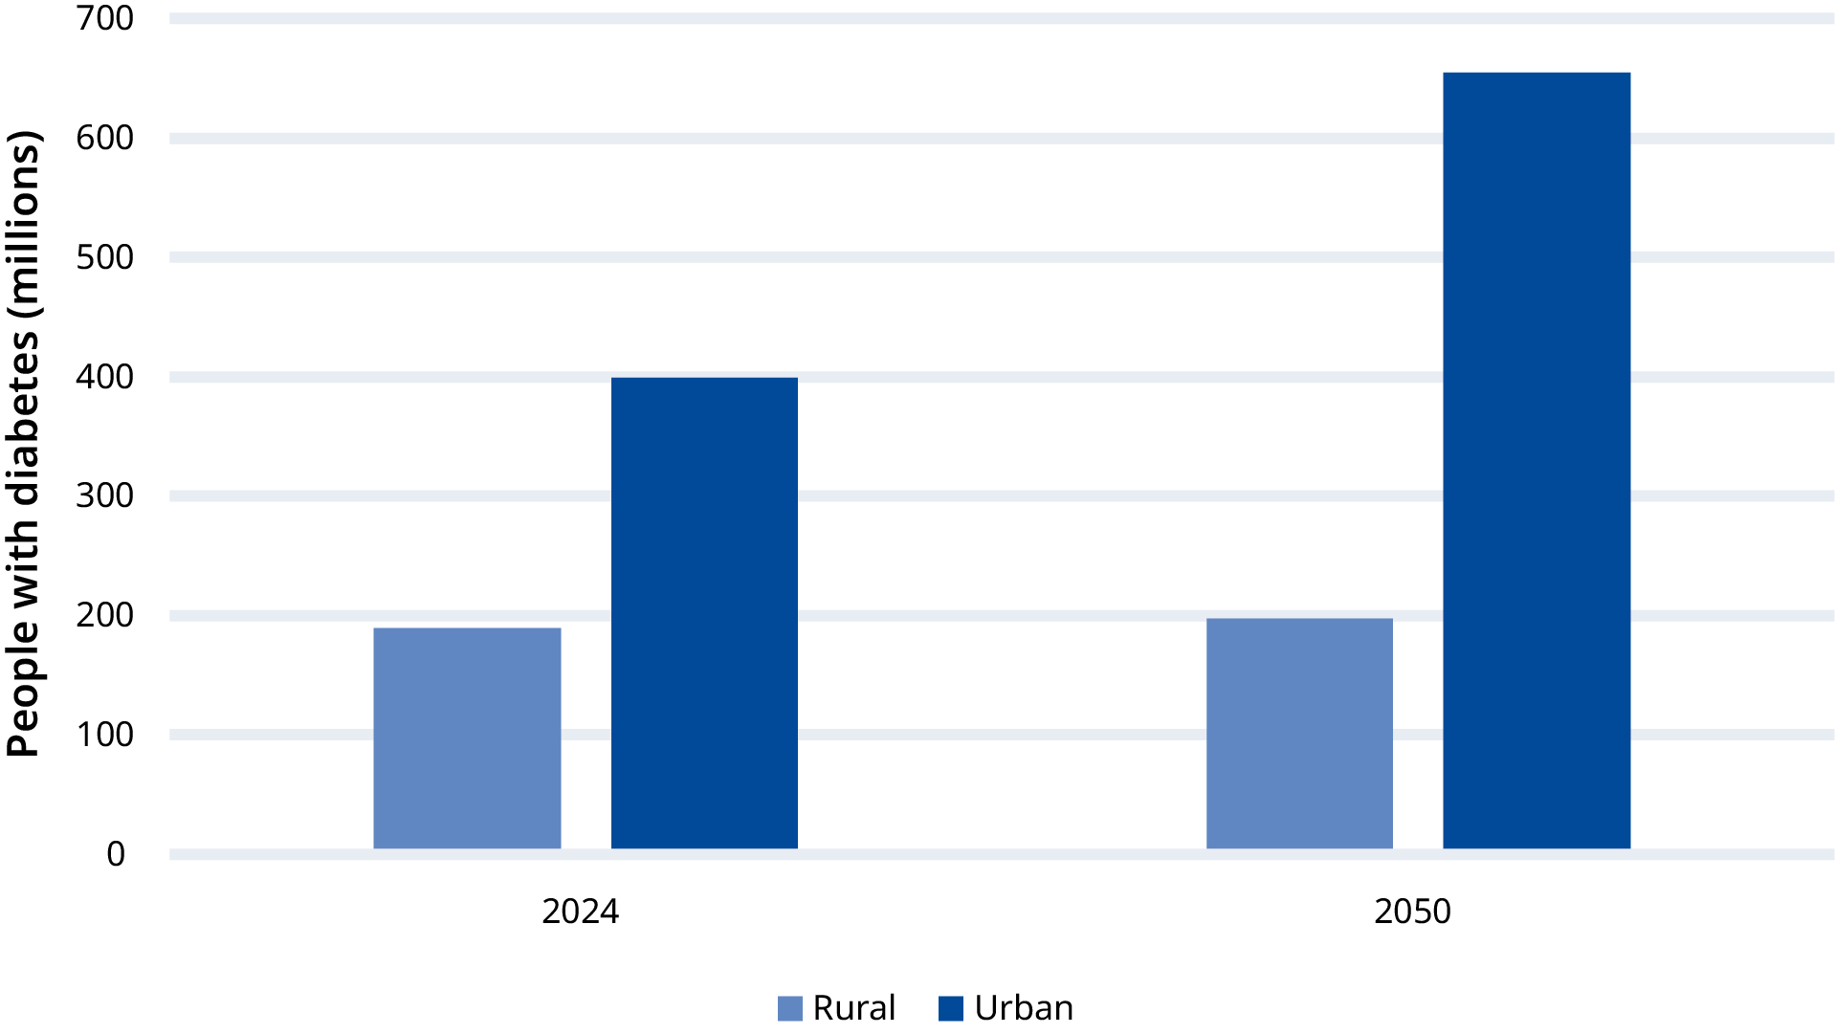
Number of adults with diabetes
Adults aged 20-79 years living in urban and rural areas in 2024 and 2050

Slide 9
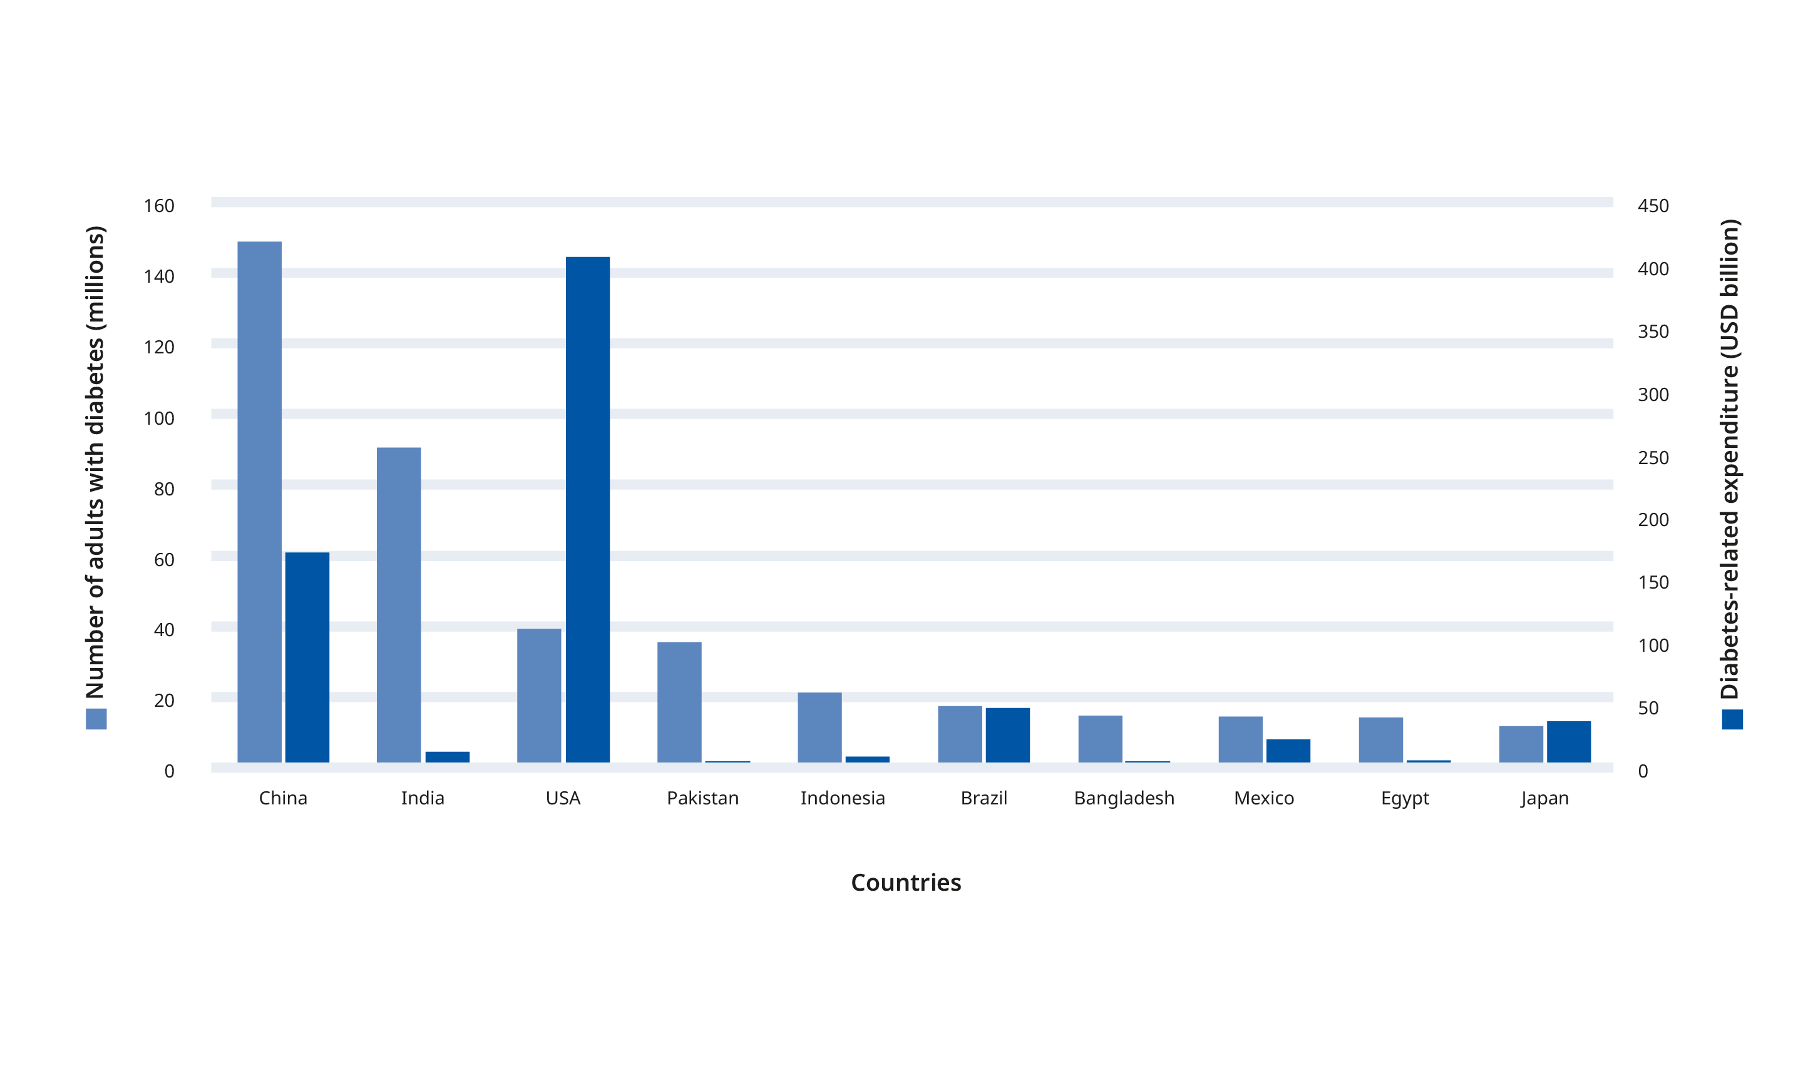
Top 10 countries with diabetes
Adults aged 20-79 years and diabetes-related health expenditure, 2024

Slide 10
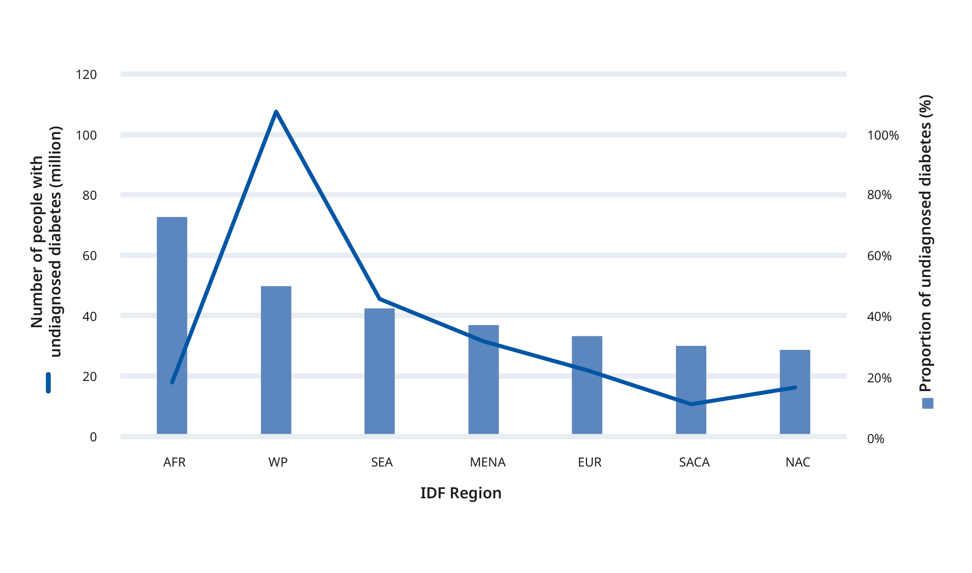
Number and proportion of adults with undiagnosed diabetes
Aged 20-79 years, per region, 2024

Slide 11
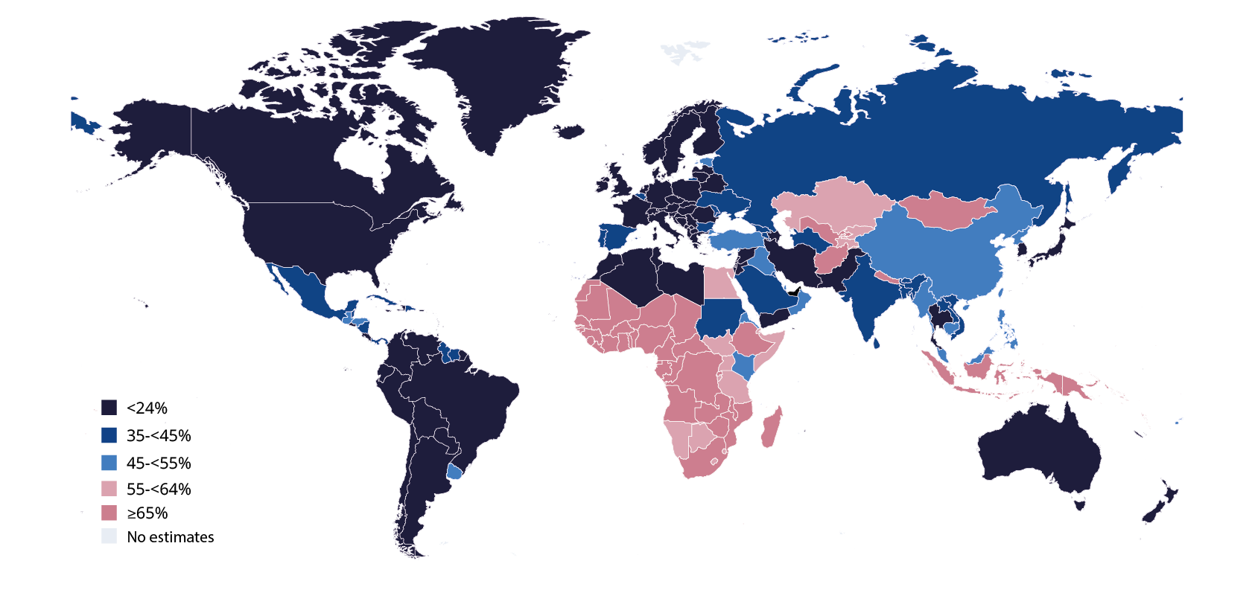
Proportion of adults with undiagnosed diabetes
Aged 20-79 years by country, 2024

Slide 12
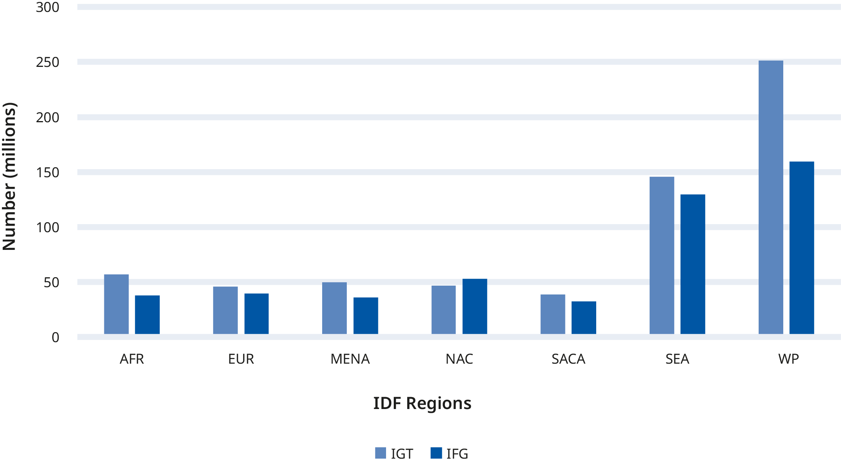
Impaired glucose tolerance and impaired fasting glucose
Per IDF Region, 2024

Slide 13
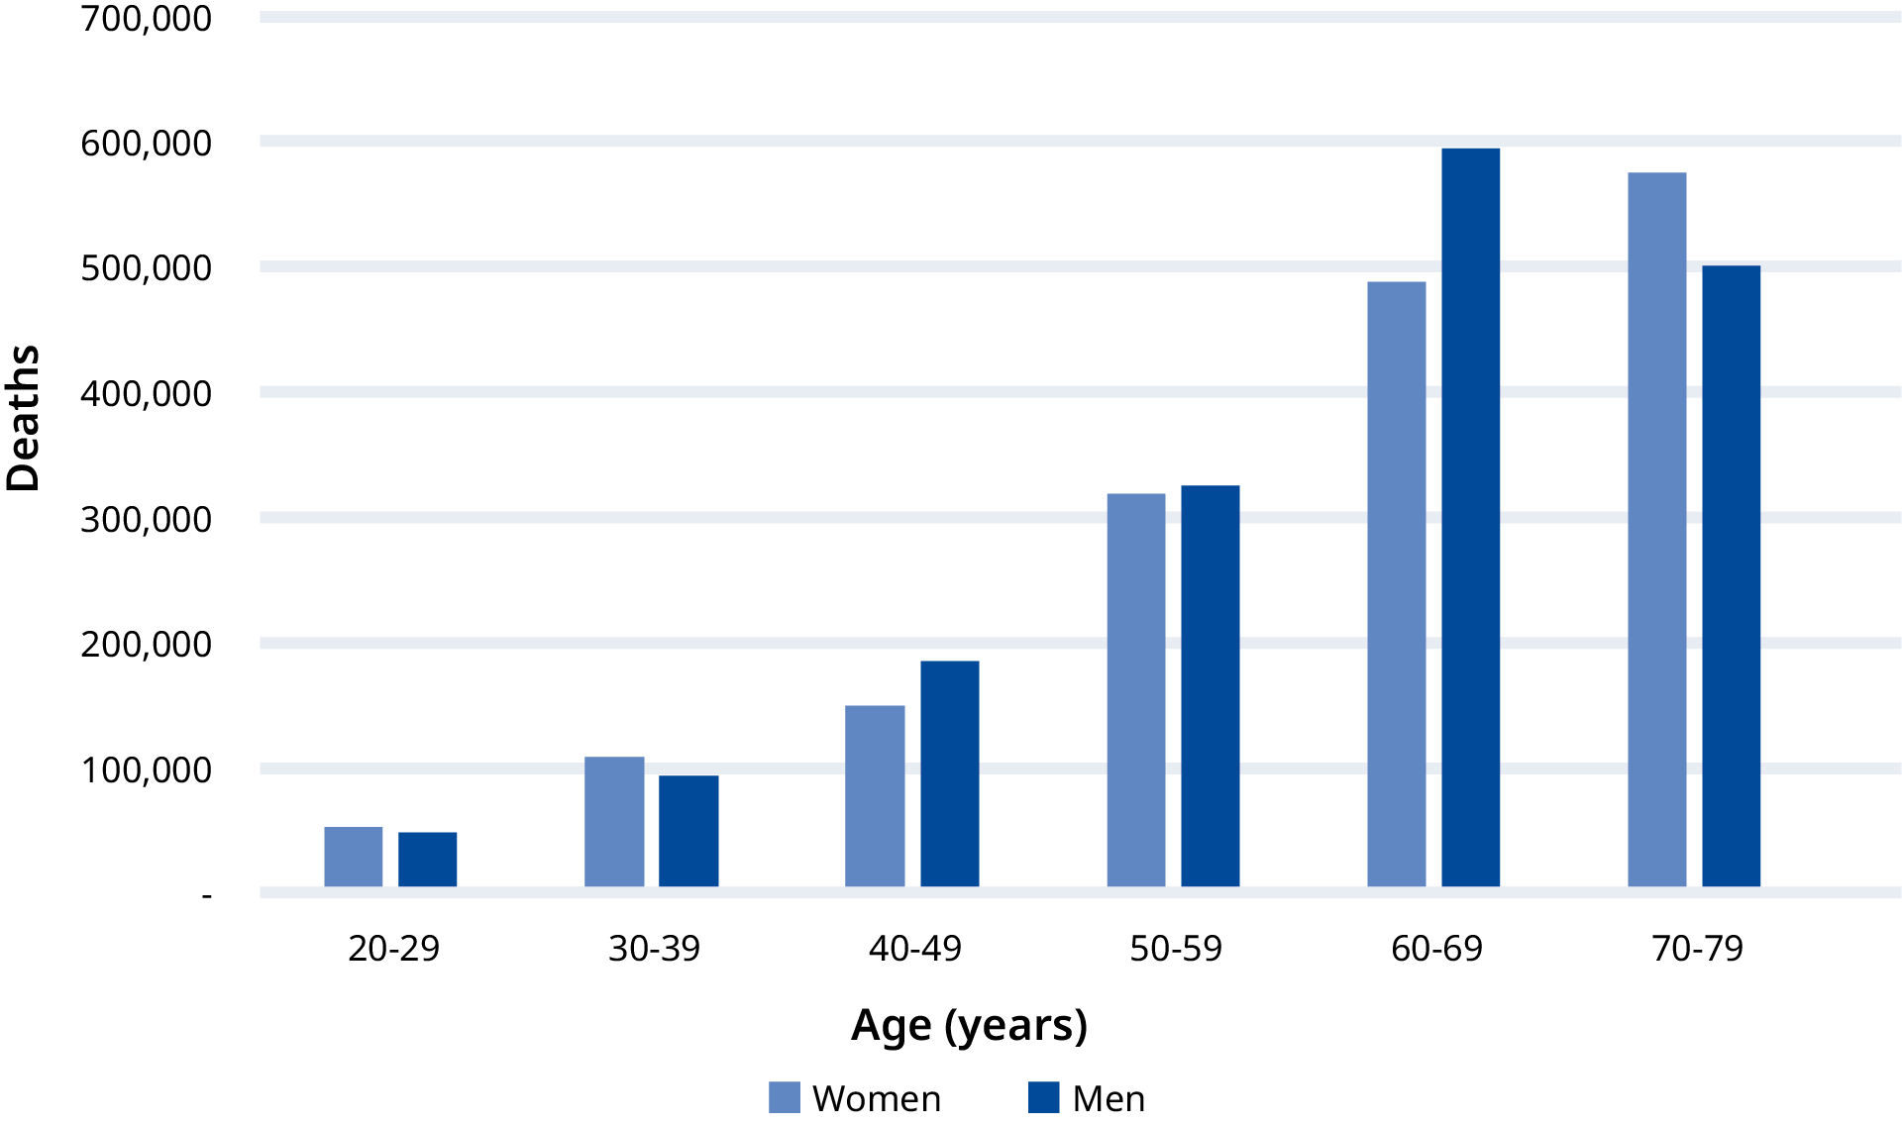
Number of deaths by sex and age
Aged 20-79 years, 2024

Slide 14
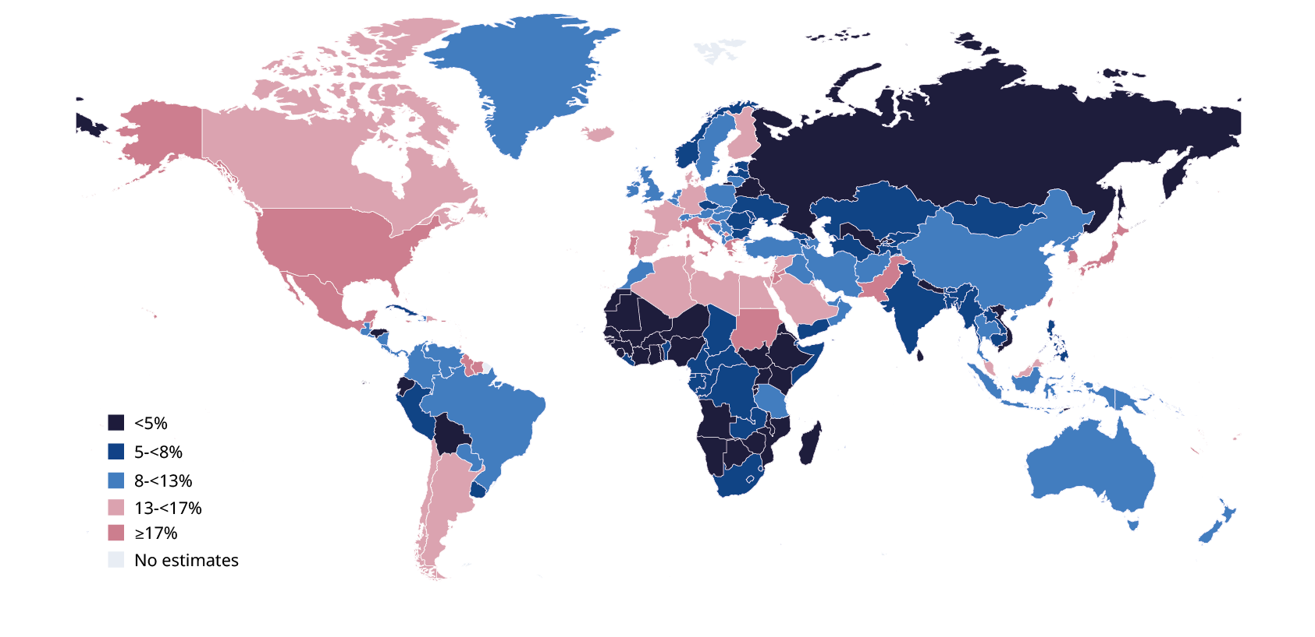
Proportion (%) of adults who died from diabetes
Aged 20-79 years, by country, 2024

Slide 15
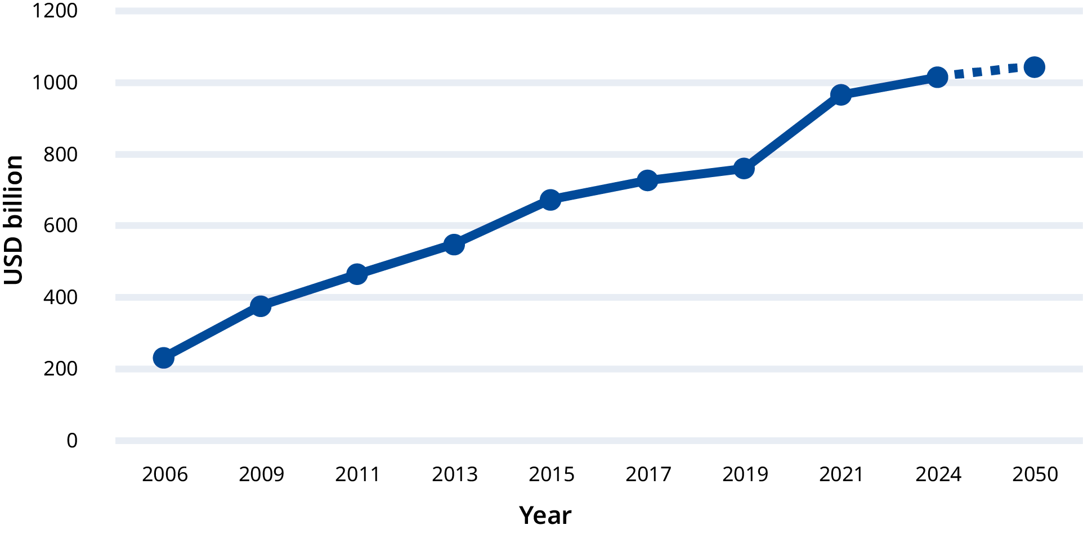
Total diabetes-related health expenditure for adults
Aged 20-79 years with diabetes, USD

Slide 16
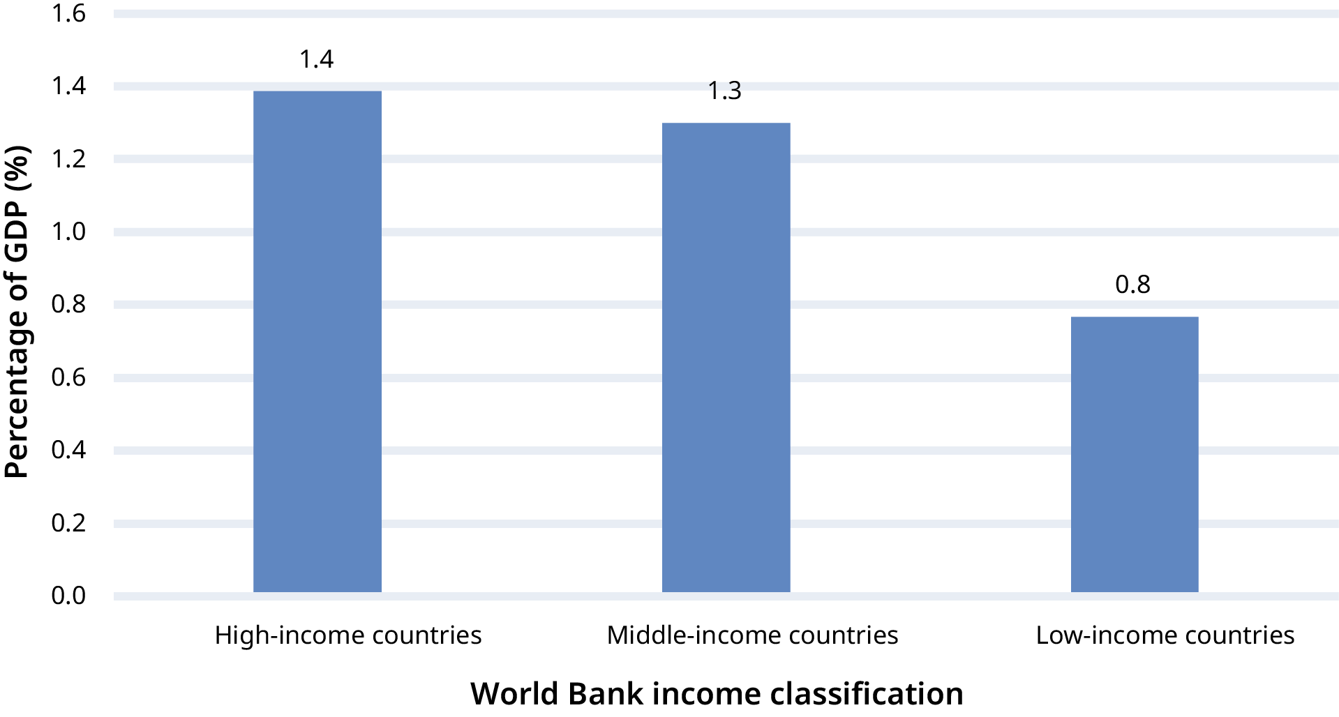
Diabetes-related health expenditure as a percentage of Gross Domestic Product (GDP)
By World Bank income classification, 2024

Slide 17
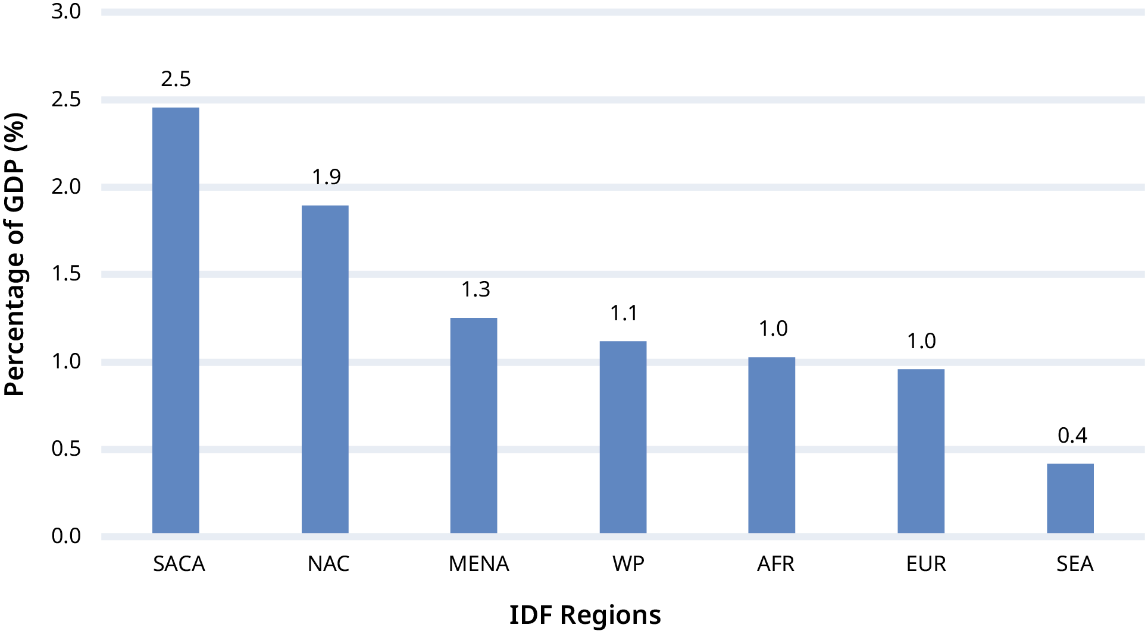
Diabetes-related health expenditure as a percentage of Gross Domestic Product (GDP)
By IDF Region

Slide 18
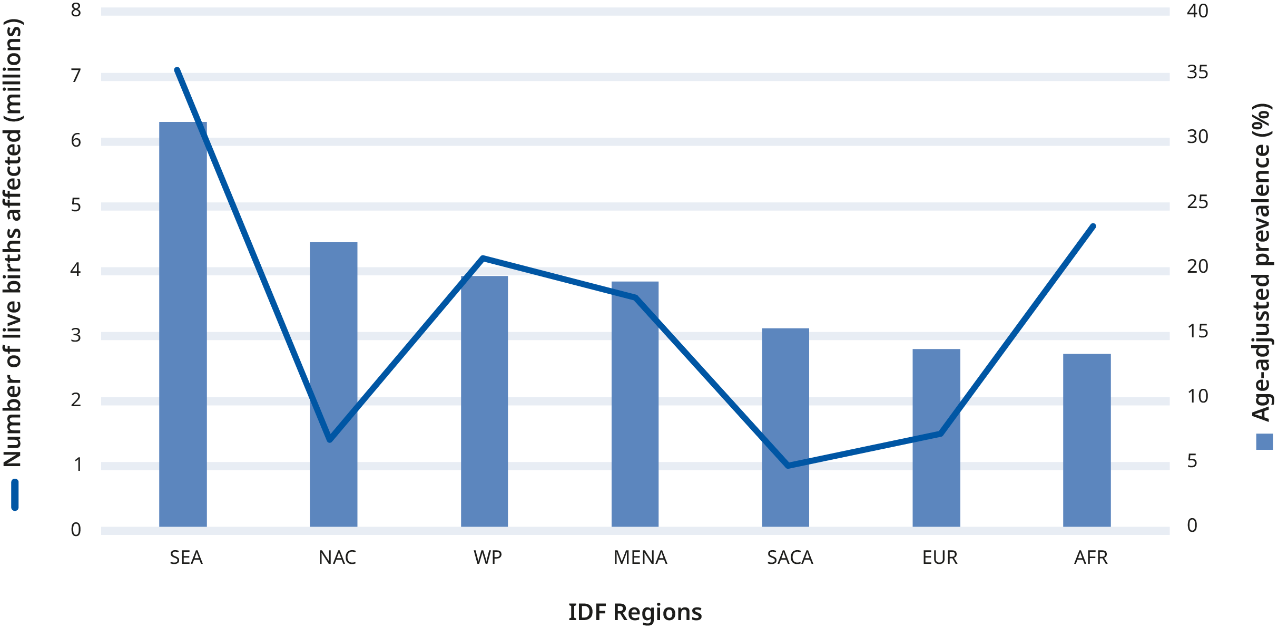
Hyperglycaemia in pregnancy
By IDF Region, 2024

Slide 19
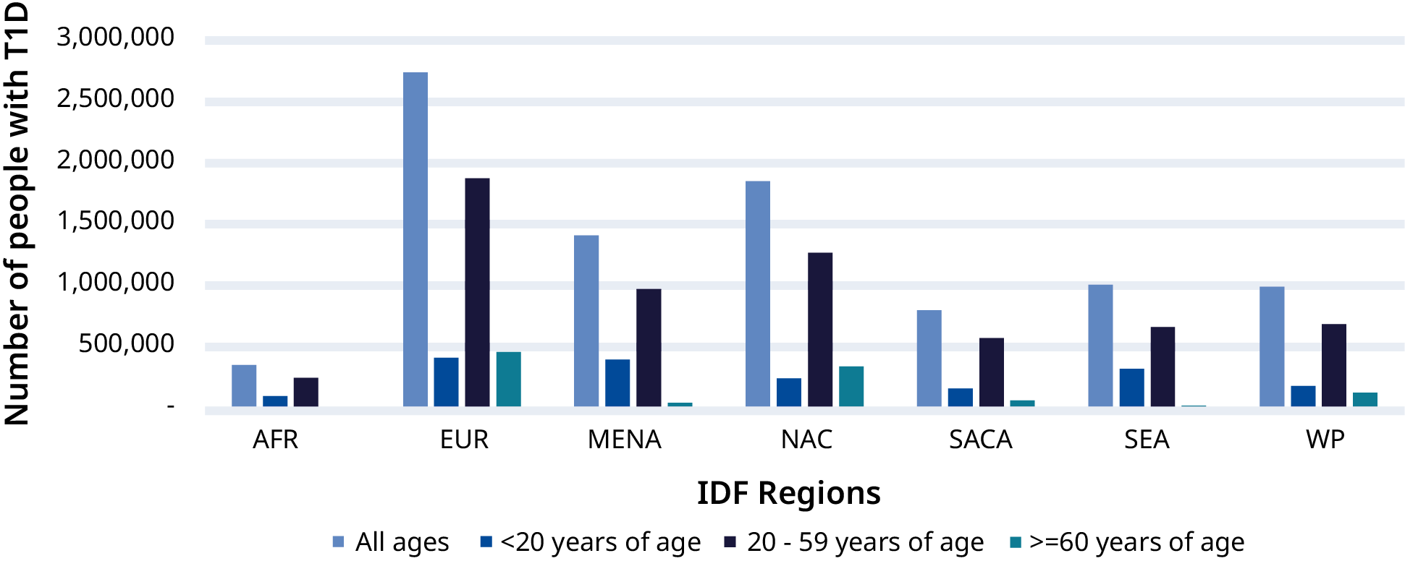
Type 1 diabetes
Number of people with type 1 diabetes by IDF Region, 2024

Slide 20
Limitations
Our definition of diabetes is based on an epidemiological definition and we require only one abnormal glucose value, compared to a clinical diagnosis where abnormal glucose on two tests is required to make a diagnosis.
Raw data is subject to heterogeneity in terms of calendar year, diagnostic method, representativeness and precision of the study design. While we attempt to address this using analytic hierarchy process, bias may still be present.
For countries without in-country data, diabetes prevalence is extrapolated based on data from a country with similar demography, economy and language group. This may introduce error.
There is a dearth of data from the African region.
For our projections, we only consider demographic changes in age, sex and urbanisation. We do not take into account other factors that may influence diabetes incidence.

Slide 21
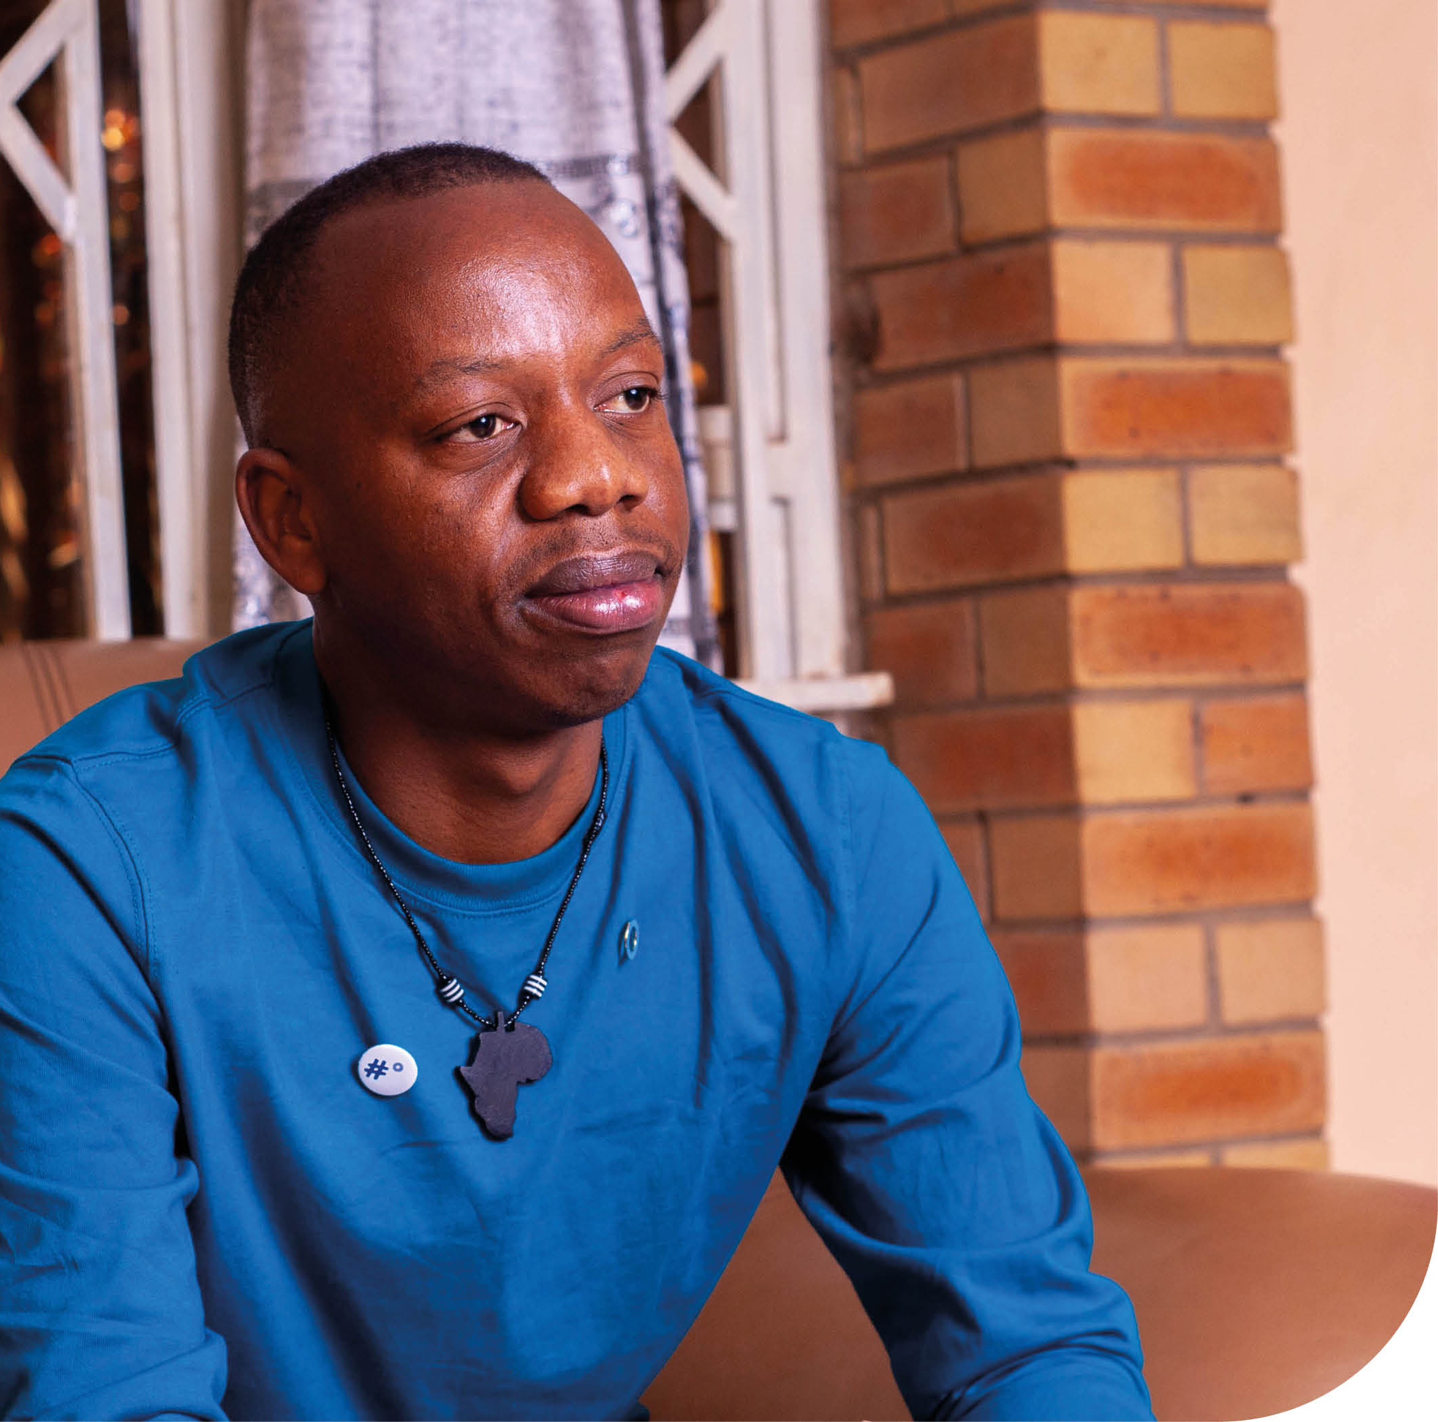
Summary
In 2024, the IDF 11 Edition of the Atlas estimates that 1/9 people aged 20-79 have diabetes
This equates to 589 million people in the world
By 2050, this number will increase to 853 million
There still remain gaps in our estimates due to absent and low-quality data in some parts of the world
There is a strong need for effective intervention strategies and policies to stall the increase in the number of people developing diabetes
Tinotenda Dzikiti, Zimbabwe - Living with type 1 diabetes

Slide 22



Acknowledgements
IDF Diabetes Atlas, 11th Edition Committee
Co-Chairs
Dianna J Magliano (Co-Chair), Edward J Boyko (Co-Chair).
Special Interest Group (SIG) leads:
Mohammed K Ali, Kaarin Anstey, Gillian Booth, Bruce B. Duncan Anthony J. Hanley, William H. Herman, Elbert Huang, Graham D. Ogle, David R. Owens, Meda E Pavkov, Naveed Sattar, Elizabeth Selvin, David Simmons, Alan Sinclair, Matilde Monteiro-Soares, Rebecca L. Thomas, Sarah Wild.
Special Interest Group (SIG) members:
Ahmed H. Abdelhafiz, Ranjit Mohan Anjana, Elizabeth Barr, Abdul Basit, Srikanth Bellary, Dominika Bhatia, Theresa Boyer, Isabelle Bourdel-Marchasson, Louise Maple Brown, Bertrand Cariou, Weihan Cao, Carlos Celis, Thora Chai, Qinyu Chen, Benjamin Chidiac, Tawanda Chivese, Faraja S. Chiwanga, Tali Cukierman-Yaffe, Dana Dabelea, Natalie Daya Malek, Shutong Du, Daisy Duan, Justin B. Echouffo Tcheugui, Aoife M Egan, Emeka Ejimogu, Ranmalee Eramudugolla, Michael Fang, Courtney Fischer, David Flood, Laercio Joel Franco, Peggy Gao, Jen Manne-Goehler, Gabriel A Gregory, Zijing Guo, Sarega Gurudas, Jessica Harding, Lucas Crescenti Abdalla Saad Helal, Jiahuan Helen He, Cheri Hotu, Jiaqi Hu, Hamidul Huque, Jincy Immanuel, Ayuba Issaka, Steven James, Tripti Joshi, Emily Okeefe, Dimitrios Kazantzis, Shihchen Kuo, Rodrigo M. Carillo-Larco, Michael Laxy, Naomi Levitt, Xia Li, Andrea On Yan Luk
Ronald Ma, Stefania Maggi, Jayanthi Maniam, Maja E.Marcus, Jean Claude Mbanya, Natalie McGlynn, Yoshihisa Miyamoto, Hiliary Monteith, Jedidiah Morton, Ayesha A. Motala, Ezekiel Musa, Valentina Naumovski, Katherine Ogurtsova, Bige Ozkan, Emily Papadimos, Odette Pearson, Catherine Pihoker, Justin Porter, R. Guha Pradeepa, Berhe Sahle, Forough Sajjadi, Ambady Ramachandran, Thomas Robinson, Mary Rooney, Julian Sacre, Jithin Sam Varghese, Jacqueline Seiglie, Baiju Shah, Jonathan Shaw, Sobha Sivaprasad, Eugene Sobngwi, Jannet Svensson, Robyn Tapp, Felix Teufel, Sathish Thirunavukkarasu, Brittney Tiffault, Dunya Tomic, João Vasco Santos, Madhuri Venigalla, Siddharth Venkatraman, Amelia Wallace, Caroline Wang, Fei Wang, Hui Wang, Donald Warne, Mahmoud Werfalli, Hannah Wesly, Xilin Yang, Lili Yuen, Farhan Zaidi, Ping Zhang, Rui Zhang, Wei Zhang, Henry Zhao, Lidan Zheng, Zhiguang Zhou.
Editorial team
Dianna J. Magliano, Edward J. Boyko, Irini Genitsaridi, Lorenzo Piemonte, Phil Riley, Paraskevi Salpea.
Corporate sponsors
The IDF Diabetes Atlas 11th edition has been produced thanks to unrestricted educational grants from

Slide 23
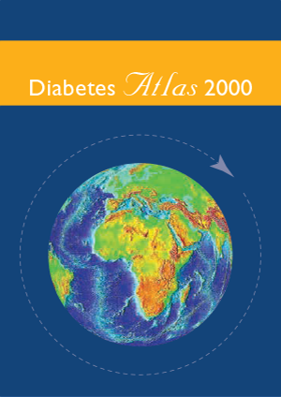
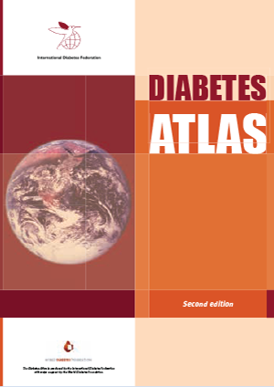
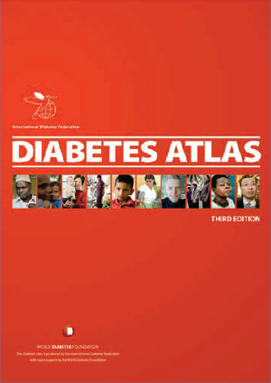
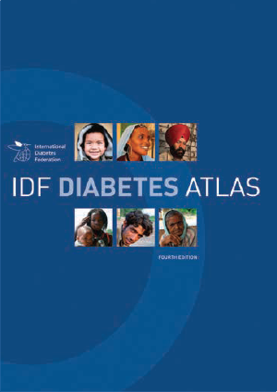

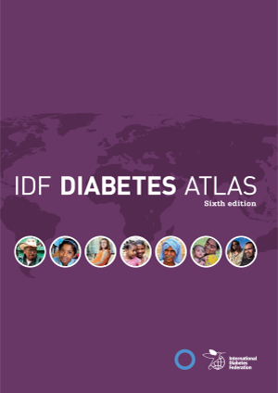
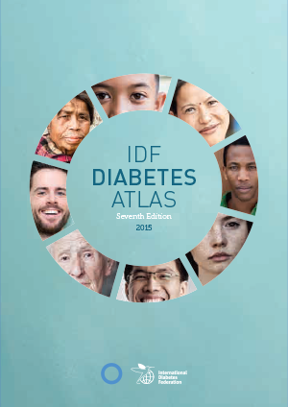
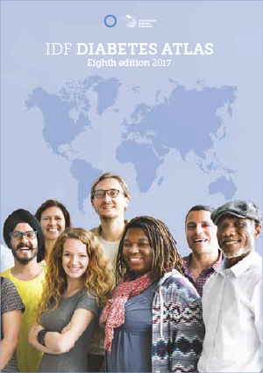
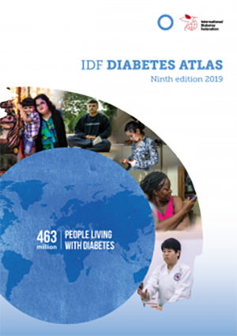
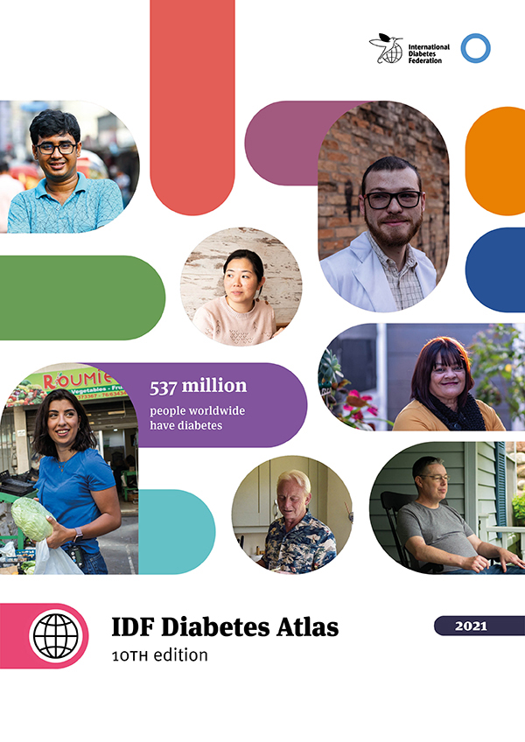
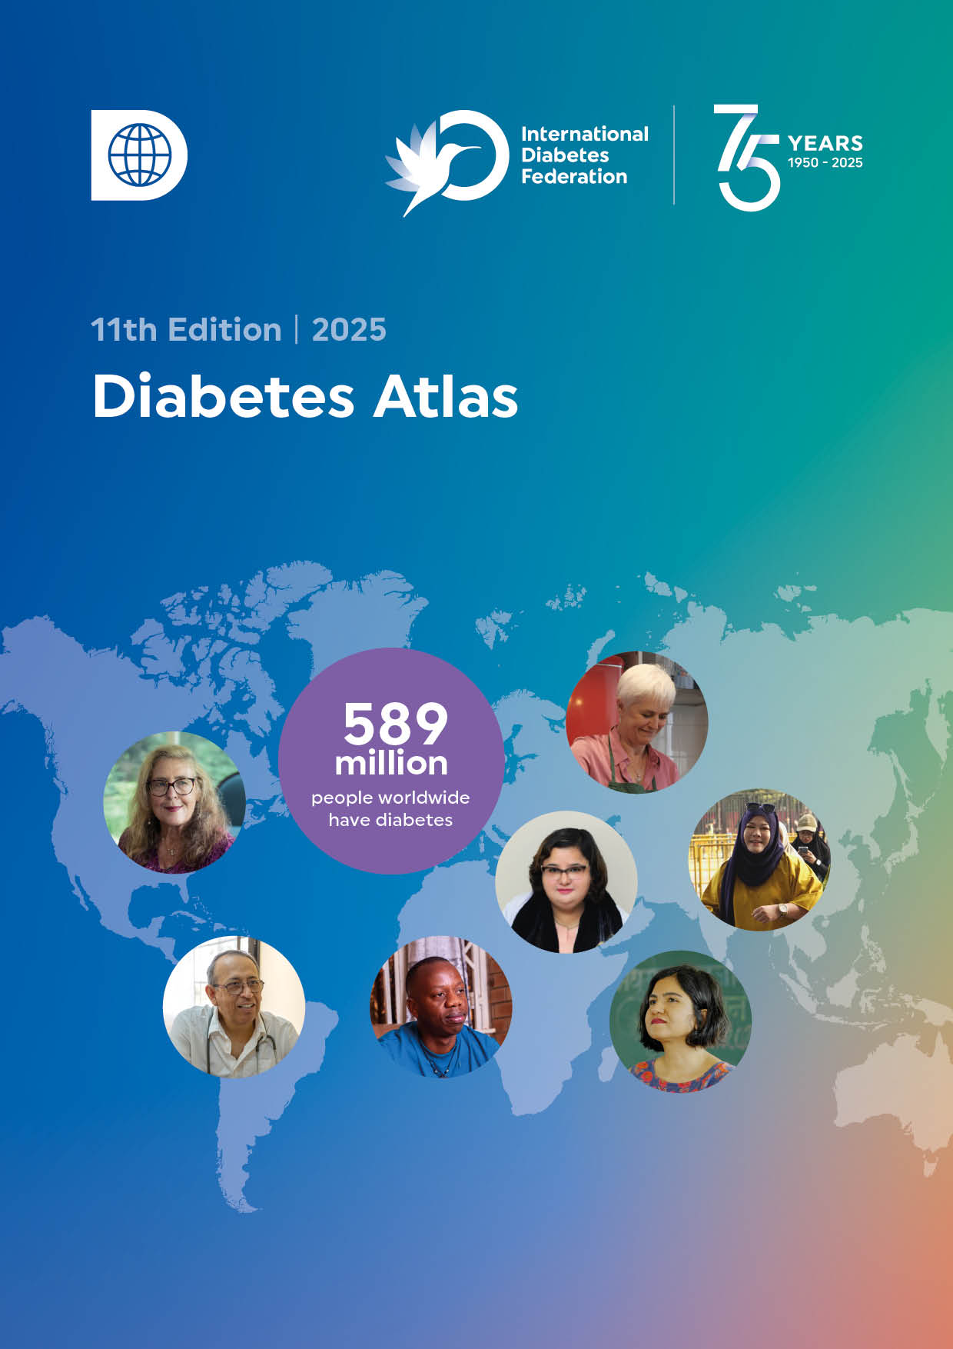
All editions of the IDF Diabetes Atlas
2000-2025

